Slide 1

IOT TEAM PROJECT 2020 REPORT
(12/03/2020)
Report by: IOT TEAM

Slide 2
IOT Project Summary
No | Projects Name | Status | Costdown OP | Save Cost($) | Owner Main | Due Date | Remark
1 | Descates Project (Website) | Finished | - | - | Auto-Ban | 9/15/2020 | Close
2 | MOH Project Management (Website) | Finished | - | - | Auto-Ban | 11/10/2020 | Close
2 | Tooling room management (Website) | Design | - | - | Auto-Ban | 12/10/2020 | On Going
3 | Mobile App For System Smart Factory (Mobile App) | Design | - | - | Auto-Nghia | 01/20/2021 | On Going
4 | System Smart factory Management (Website) | Improve | - | - | Auto-Nam | 02/10/2021 | On Going
5 | System show Line balance | Design | - | - | Auto-Nam | 12/12/2020 | On Going

Slide 3
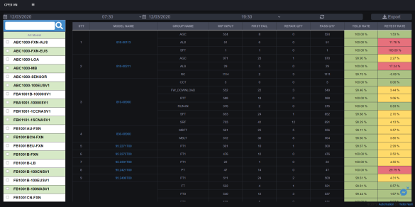
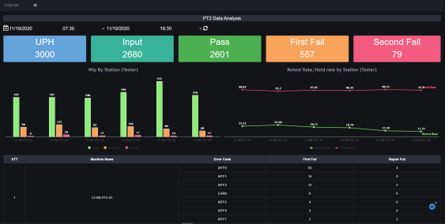
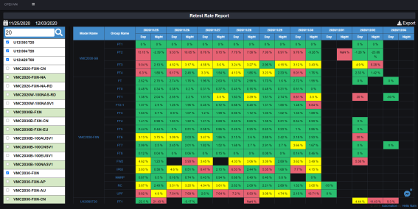
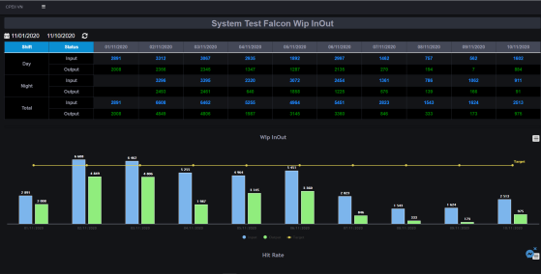
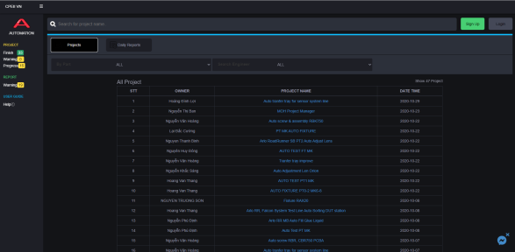
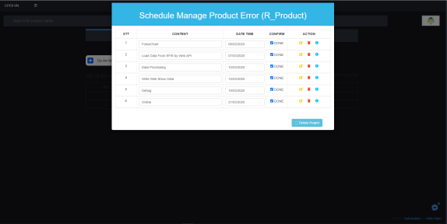
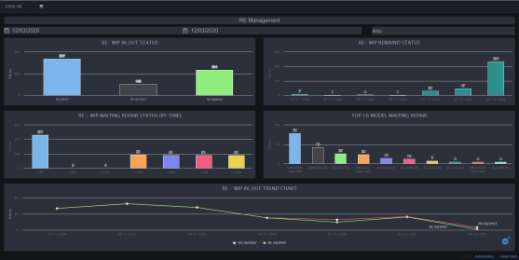
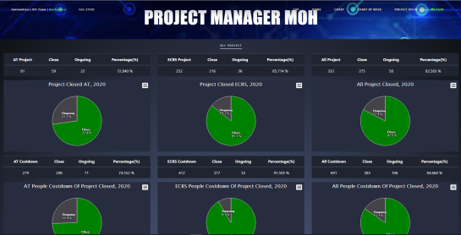
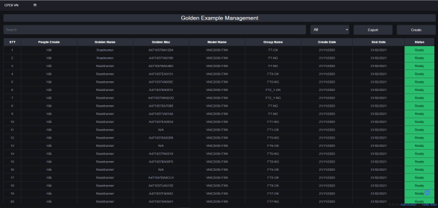
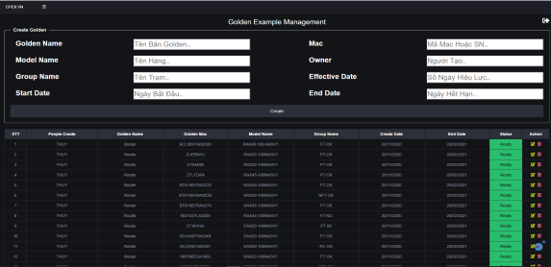
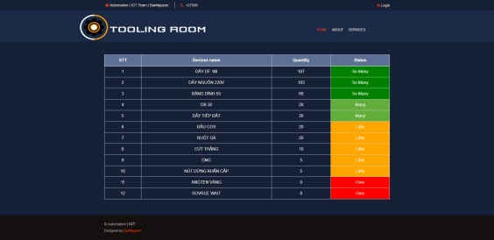
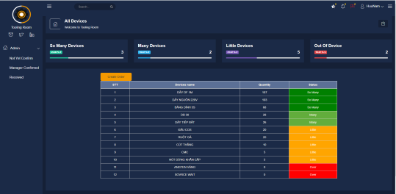
1:System Smart Factory (Website)
1. Dashboard
2. Engineer
3. RE and MOH
4. Golden Management
5. Tooling Room Management

Slide 4
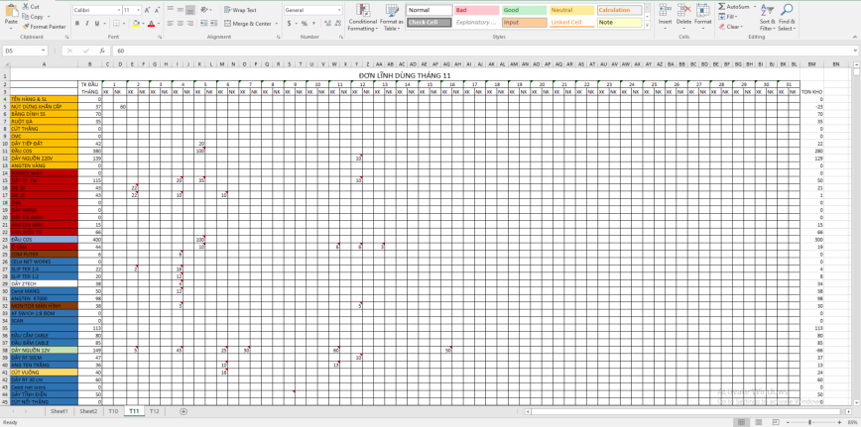

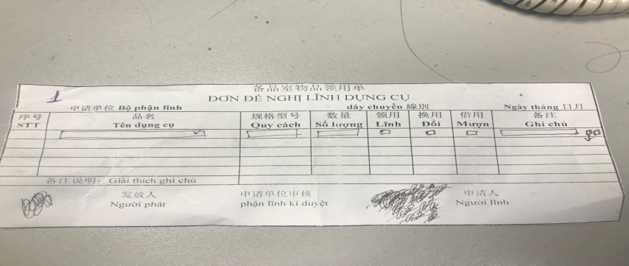
1.1 Tooling Room Management (Website)
Before Improve
After Improve
Schedule of Tooling Room Management
11/08
11/12
11/15
12/04
12/06
12/10
Make Idea
Design DB
Design Page
Up To Server
Debug Run
Online

Slide 5
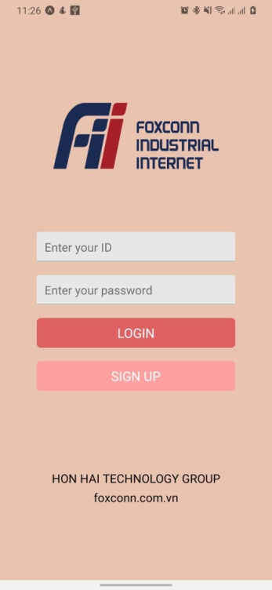
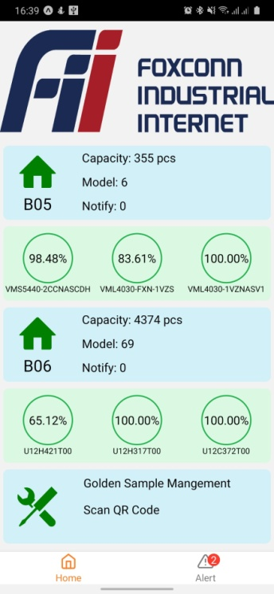
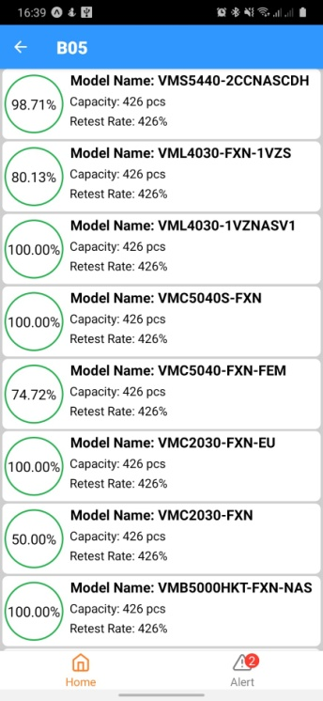
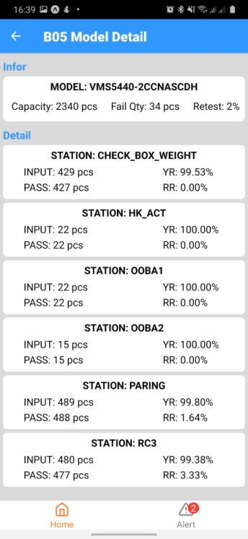
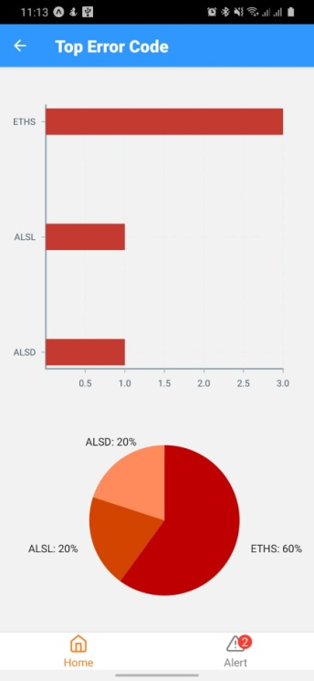
1.2 Mobile App
1: Screen login
2:Home
3:View All Model
4:View Detail Model
5:Top Error Code
6:Golden Example
Management
(3)
(5)
(4)
(2)
(1)
(6)
Schedule of Mobile App
10/10
10/20
11/05
11/28
12/02
12/05
Make Idea
Design API
Design Screen
Up To Server
Debug Run
Online

Slide 6





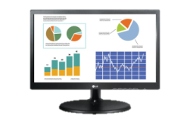

1.3 System Line balance (Owner:Auto-Nam)
Flow chart
Engineer ME,PE,PD…
IE Engineer
The FII server retrieves the Data from IE and SFIS then calculates it
Meeting
ALARM
Line Balance issue
Auto Database
analysis
Show important imformation
y
Show alarm, highlight relevant parts by auto send mail and wechat
SFIS Database
retraining
Operator issues
Schedule of System Line balance
12/05
12/07
12/08
12/10
12/11
12/12
Make Idea
Design Database
Design Page
Up To Server
Debug Run
Online

